Slide 1
Generating noisy speech data from clean data in the frequency domain using Deep Learning Methods
Week – 6
Name: Shashank Shirol
University: Manipal Institute of Technology
Duration of the presentation: ~10 mins.

Slide 2
Tasks to be completed:
Update the Normalization and LSD calculation code:
Update Time-Alignment method to use cross-correlation on spectrograms instead of the time-series data.
Use Loudness Normalization to prevent changing the signal characteristics.
Translate the Energy equalization code from MATLAB to Python.
Train SinGAN on the following combination:
Train: RATs Noise (taken from a noisy sample) (8k)
Paint: clean RATs sample (8k)
Study the official SinGAN implementation to determine how it’s put up and how it needs to be updated.

Slide 3
Updating the Norm-LSD code: (I)
Time-Alignment is done in following steps:
Pad the smaller signal with 0s to match the length with the bigger signal.
Add a small random noise to the 0s in the signal to avoid log₁₀(0) (-inf) problem in spectrograms.
Compute the lag (no. of samples to move) in the signals by performing cross-correlation on the spectrograms (taking mean across frames) of the signals.
Use numpy to correct the lag by rolling required number of samples.
Normalization is done by matching the dBFS (decibels relative to full-scale) of the two signals:
This allows us to achieve loudness normalization.
We make use of the pyDub library for this normalization.
A signal’s amplitude is matched with a target amplitude by using their dBFS values.
Energy equalization is performed between a signal and a reference signal. Here, we only consider the top 10% data to calculate gain.

Slide 4

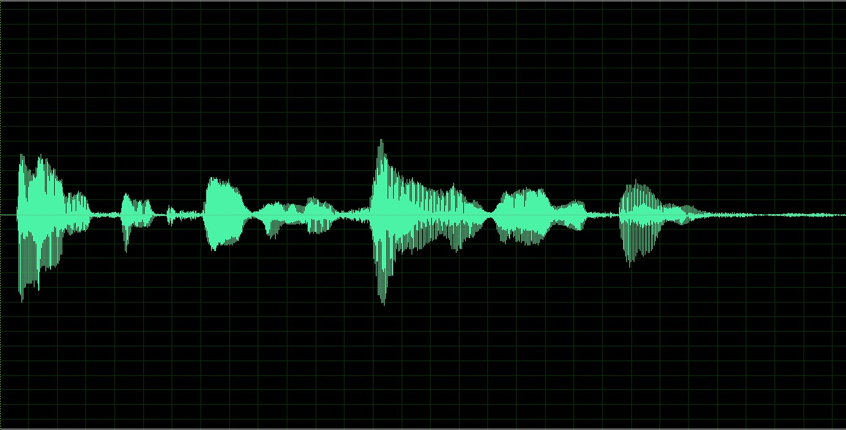
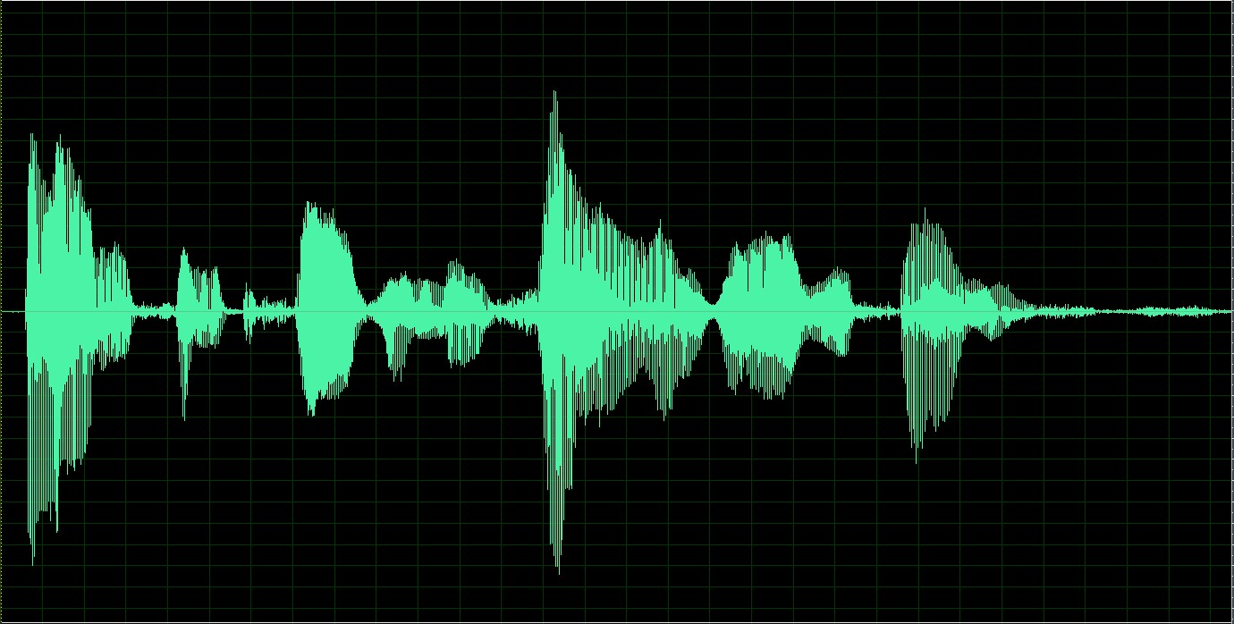
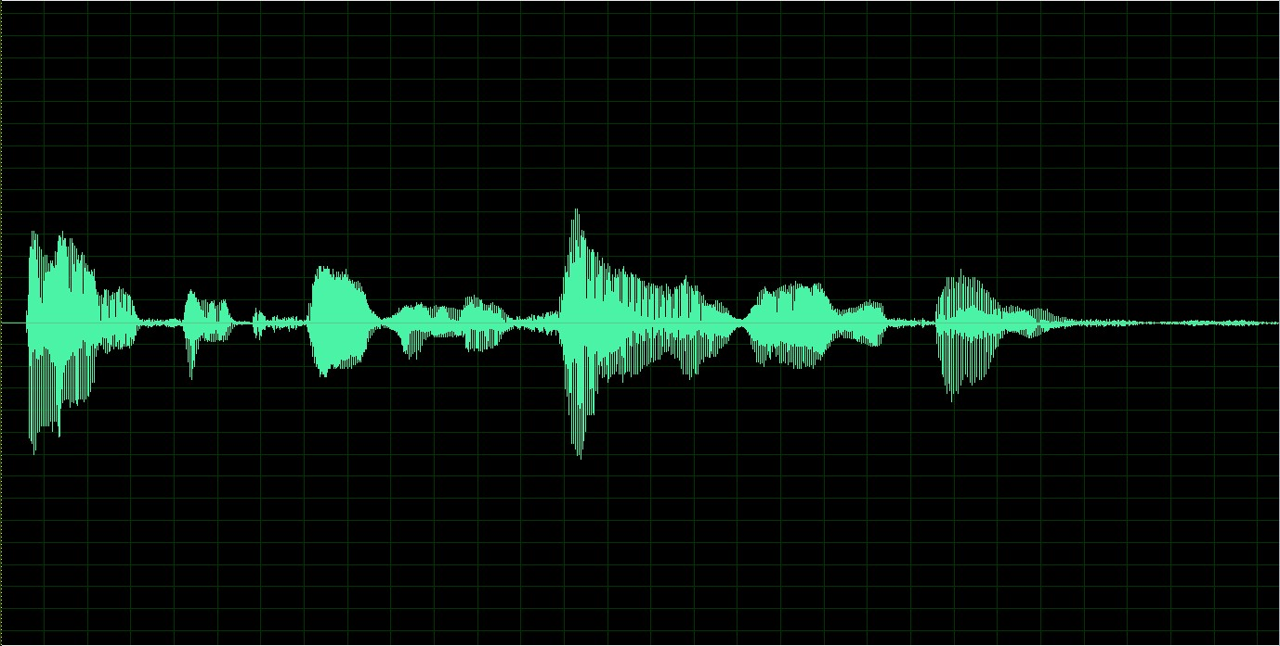
Updating the Norm-LSD code: (II)
Normalization results:
Reference
To Normalize
Normalized

Slide 5
Training SinGAN with RATs Noise + using clean RATs sample for generation: (I)
Training Image: RATs Noise (8k) Paint Image: RATs Female Clean (8k)
Scale=5 output
Training Audio:
LSD between ground truth noise and output at:
start_scale=1: 12.297
start_scale=2: 13.501
start_scale=3: 13.230
start_scale=4: 13.471
start_scale=5: 13.887
Observation: Yields marginally better results than when SinGAN is trained with noisy sample. Output for scale=1 remembers that frequency bands 3400-3800 Hz are empty (shown on the next slide).
LSD between ground truth noise and old output at:
start_scale=1: 13.517
start_scale=2: 13.497
start_scale=3: 14.091
start_scale=4: 15.452
start_scale=5: 15.297
Scale=1 output
Ground Truth:
Paint Audio:

Slide 6
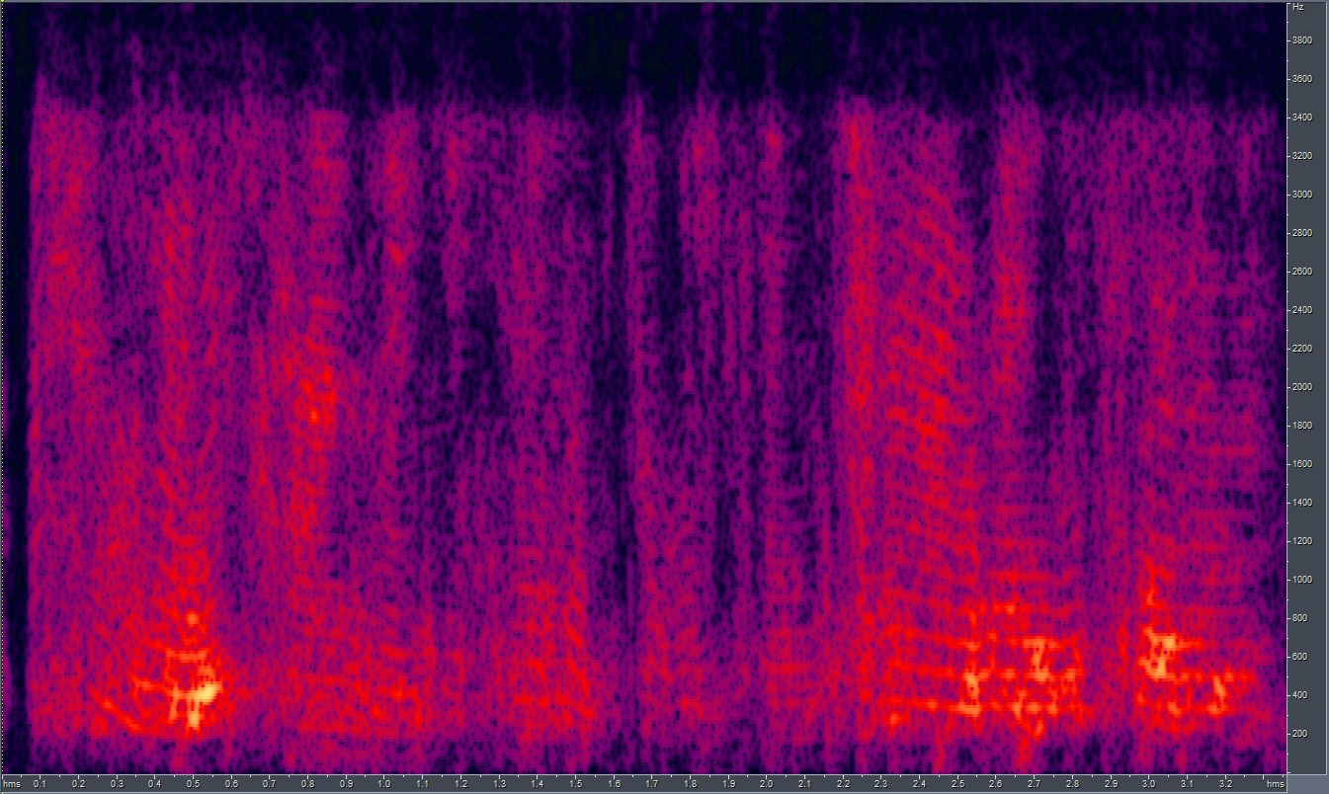
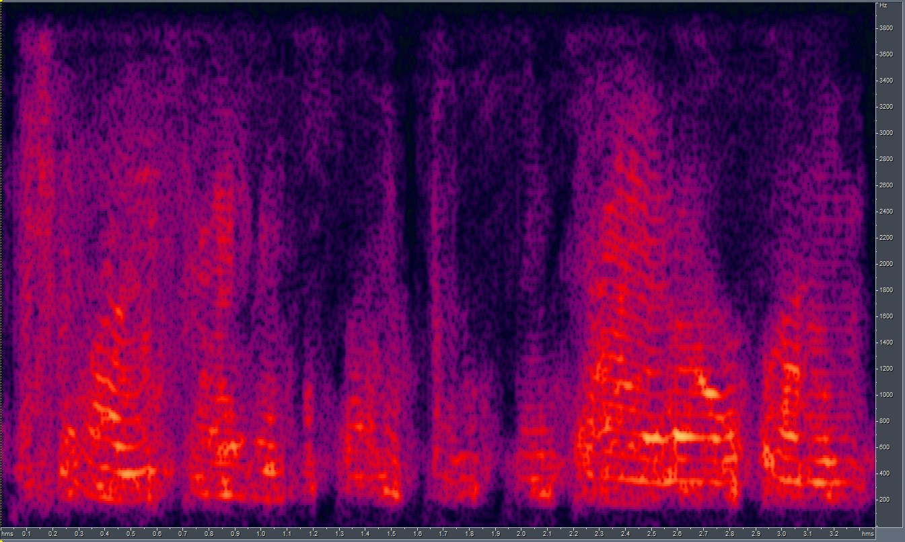
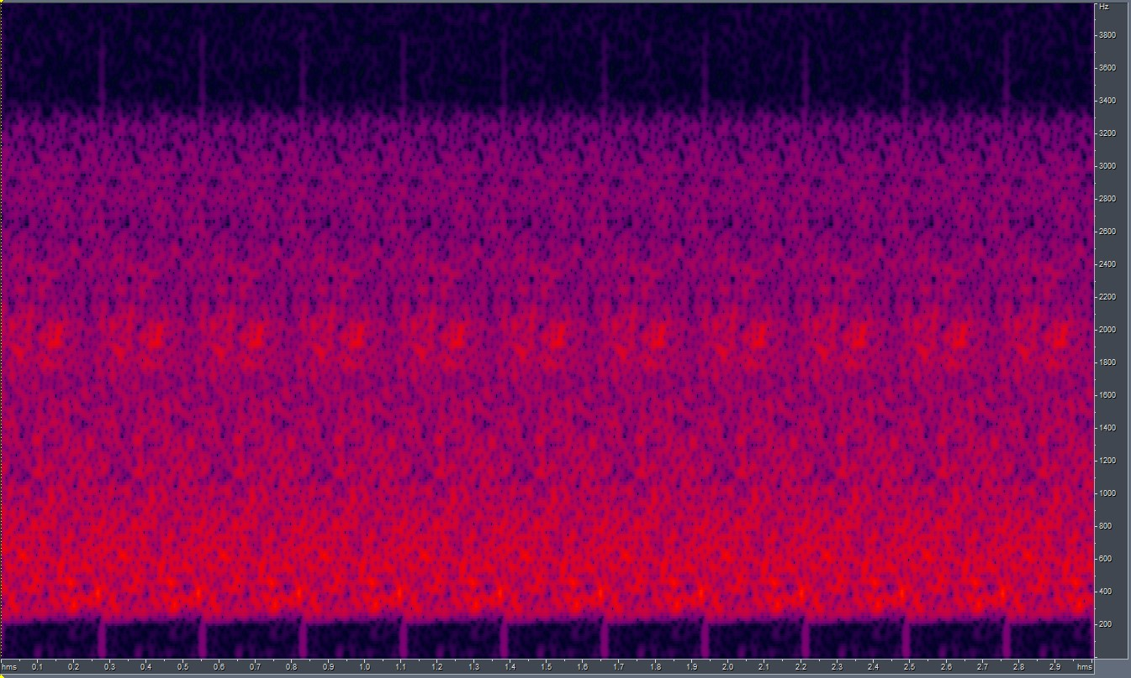
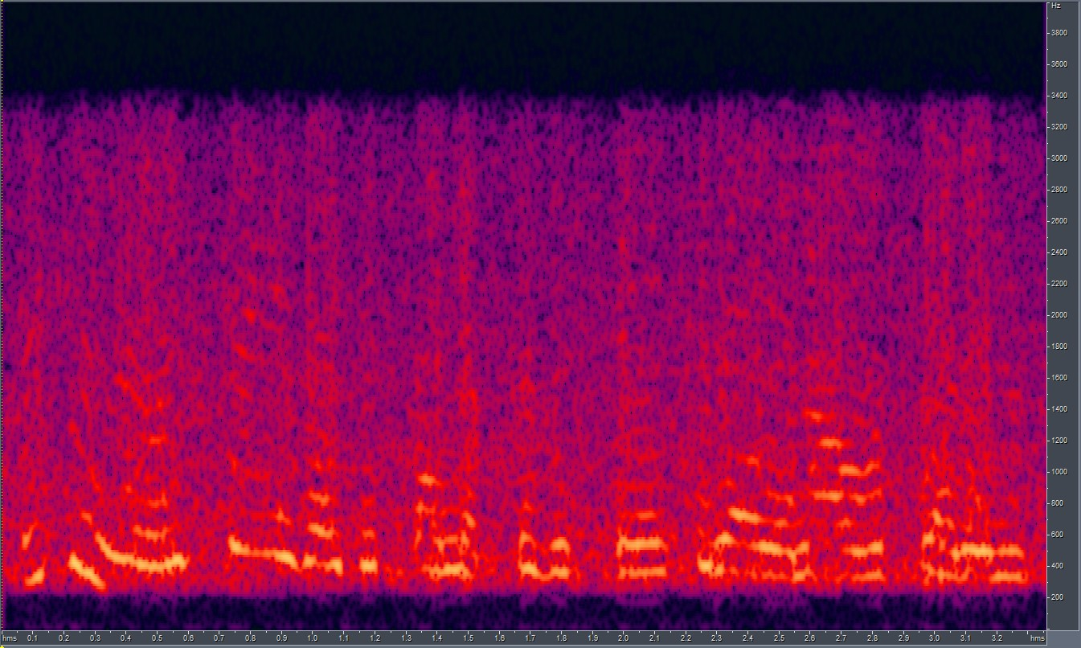
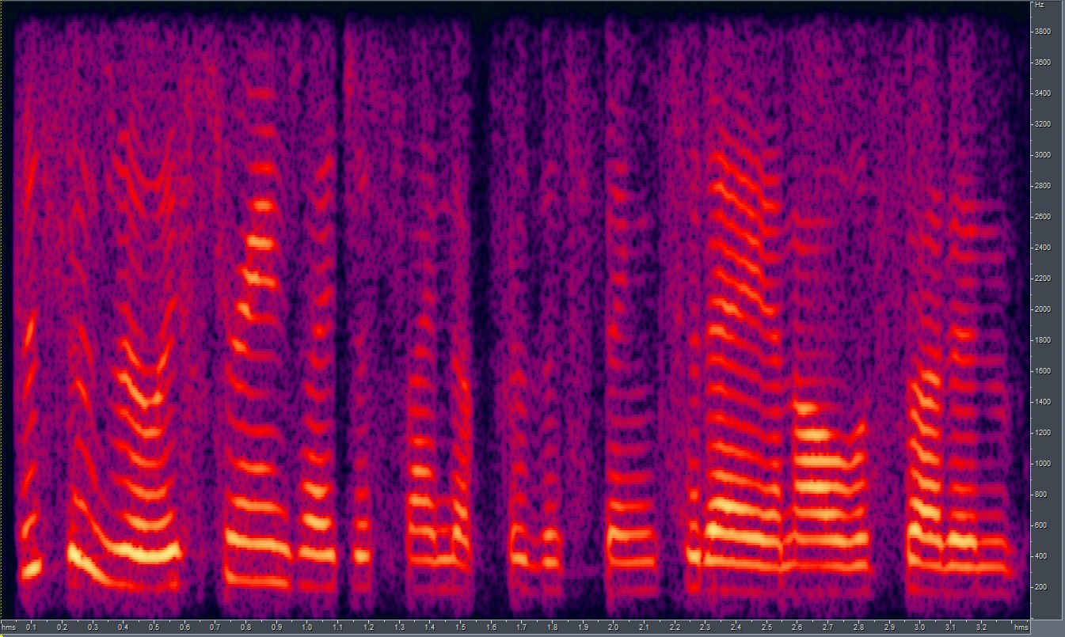
Training SinGAN with RATs Noise + using clean RATs sample for generation: (II)
Scale=1_new
Scale=1_old
GT_noise
Training Spectrogram
Paint_clean

Slide 7
Things to consider while modifying the SinGAN implementation:
We’d be doing the opposite of what SinGAN currently does – changing the size of the training image at every scale thus changing the effective size of the window.
SinGAN determines the number of scales in the model based on the size of the input training image. It uses the minimum of the length and width of the image to calculate the number of scales.
SinGAN scales the input training image to a max longest size of 250 before training. This has to be changed without hampering efficacy of SinGAN’s training.
The original implementation has a lot of unwanted code (for different tasks like Harmonization, Editing, Super resolution, animation), first step would be to clean the code and have a lighter version of SinGAN – training code + paint2image module.

Slide 8
End.

